Slide 1
Test environment setup
Lesson
19

Slide 2
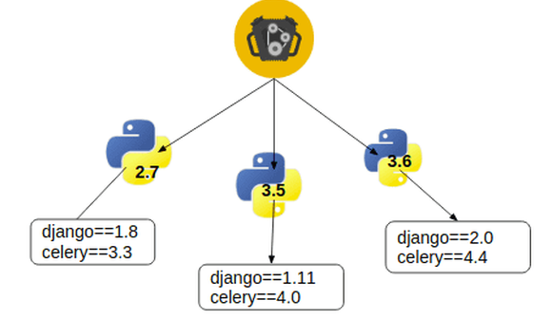
Agenda
Virtual environment
Environment variables
requirement.txt
PEP8 coding standards
Working with Date and Time
.bat file under scheduler

Slide 3
Virtual Environment
Virtualenv is a tool used to separate different dependencies required by the projects. While working on multiple projects it's a common issue that one project need a version of package that is completely different from the other one, virtualenv helps us to resolve such kind of issues.
Installing virtualenv
pip install virtualenv
Creating a virtual environment
Create a new directory called python_project and change current working directory to python_project.
To create a virtual environment inside python_project you need to write the following command.
virtualenv env

Slide 4
Activating Virtual Environment
windows
.\env\Scripts\activate
Linux
source env/bin/activate
Deactivate Virtual Environment
deactivate

Slide 5
Requirements.txt file
If Python program requires a set of external packages to be installed, requirements file is used. The file is just a list of packages optionally with versions. The file can be fed to pip command.
E.g. content of requirements.txt
requests==2.18.4
google-auth==1.1.0
Install packages (as they appear in requirements.txt) pip install –r path\requirements.txt
Get the list of all packages installed in local Python distribution (in format of conditions to follow)
pip freeze > path\requirements.txt
Get the list of all packages and the versions (in tab separated form)
pip list
5

Slide 6
Access to Environment Variables
All environment variables are available trough os.environ dictionary.
Remember that environment variables set in script do not persist when the script is over.
import os
print(os.environ["TEMP"])
print(os.environ["PATH"])
os.environ["TEMP2"] = "D:/"
import os
# Set environment variables os.environ['API_USER'] = 'SuperUser' os.environ['API_PASSWORD'] = ‘asasas’
# Get environment variables
USER = os.environ.get('API_USER’)
PASSWORD = os.environ.get('API_PASSWORD')

Slide 7
General Coding Standards
There are conventions for python described in PEP8 standard, available here: https://www.python.org/dev/peps/pep-0008/
Naming conventions are covered here: https://pypi.org/project/pep8-naming/
In general, variables and function names are in snake_case, class names start with Capital and do not use spaces, no spaces in the end of lines, sections of program (imports, globals, classes) should have two blank lines between them, etc…
A tool called pycodestyle is used to check PEP8 conformance (for old python versions the tool was called flake8). It can be installed using pip. The tool can be configured to ignore certain error types using config file(s). The details on usage is left for self training. An example output for pycodestyle is shown below:
D:\PyTrain\PythonApplication2\PythonApplication2>pycodestyle .
.\PythonApplication2.py:8:15: W292 no newline at end of file
.\MyPackage\__init__.py:1:1: W391 blank line at end of file
.\MyPackage\class_one.py:3:1: E302 expected 2 blank lines, found 1
.\MyPackage\class_one.py:7:1: W391 blank line at end of file

Slide 8
Date and Time Formatting
from datetime import datetime
# current date and time
now1 = datetime.now()
t = now1.strftime("%H:%M:%S")
print("time:", t)
s1 = now1.strftime("%m/%d/%Y, %H:%M:%S")
# mm/dd/YY H:M:S format
print("s1:", s1)
s2 = now1.strftime("%d/%m/%Y, %M:%H:%S")
# dd/mm/YY H:M:S format
print("s2:", s2)
The output is:
time: 11:35:36
s1: 09/27/2020, 11:35:36
s2: 27/09/2020, 35:11:36

Slide 9
datetime
from datetime import datetime
# Constructing datetime object
# (only first 3 args are mandatory)
a = datetime(2017, 11, 28, 23, 55, 59, 342380)
print("year =", a.year)
print("month =", a.month)
print("hour =", a.hour)
print("minute =", a.minute)
The output is:
year = 2017
month = 11
hour = 23
minute = 55

Slide 10
Sample Duration Measurement
import timeit
t_start = timeit.default_timer()
for i in range(0, 1000000):
pass
duration = timeit.default_timer() - t_start
print("Duration: {:.3f} milliseconds".format(duration))
The output is:
Duration: 0.547 milliseconds

Slide 11
Date and Tim – Date Intervals
from datetime import datetime, date
t1 = date(year=2018, month=7, day=12)
t2 = date(year=2017, month=12, day=23)
t3 = t1 - t2
print("t3 =", t3)
t4 = datetime(year=2018, month=7,
day=12, hour=7,
minute=9, second=33)
t5 = datetime(year=2019, month=6,
day=10, hour=5,
minute=55, second=13)
t6 = t4 - t5
print("t6 =", t6)
The output is:
t3 = 201 days, 0:00:00
t6 = -333 days, 1:14:20

Slide 12
Batch file
Step 1: Create the Python Script
Step 2: Save your Script
file extension is .py, e.g. countdown.py
Step 3: Create the Batch File to Run the Python Script
Step 4: Run the Batch File
double click on batch file
countdown = 10
while countdown > 0:
print ('CountDown = ', countdown)
countdown = countdown - 1
@echo on
open new file
call C:\Qwallity\Automation_02_2024\Lesson_19\env\Scripts\activate
python "of.py"
pause

Slide 13
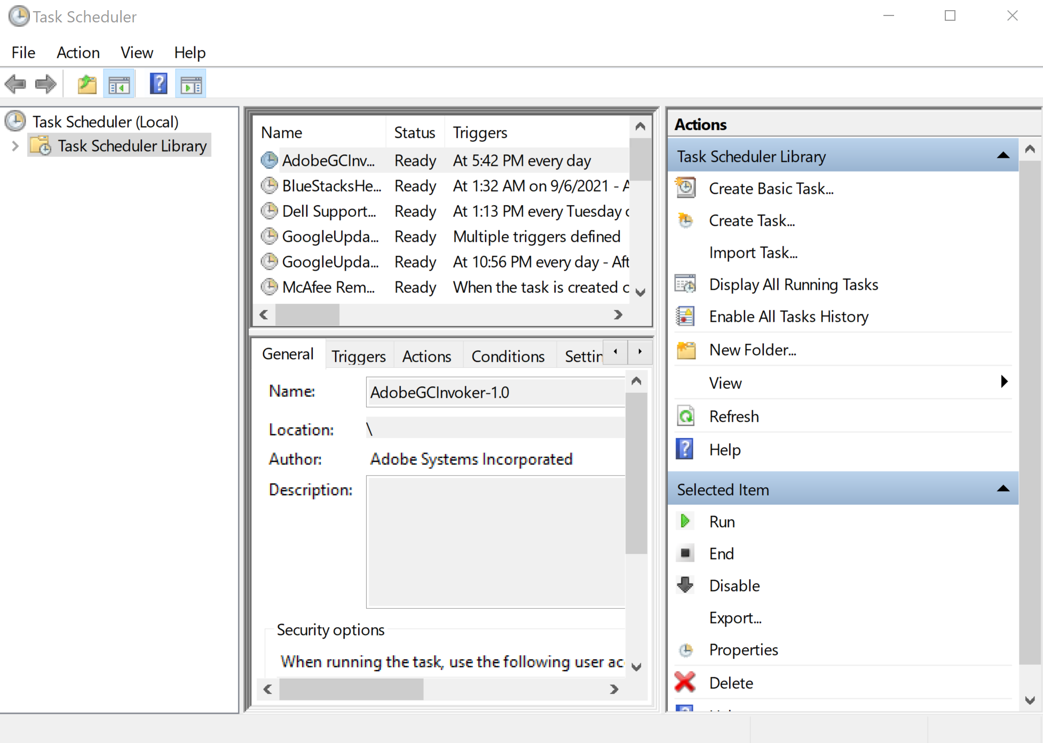
Schedule your batch file

Slide 14
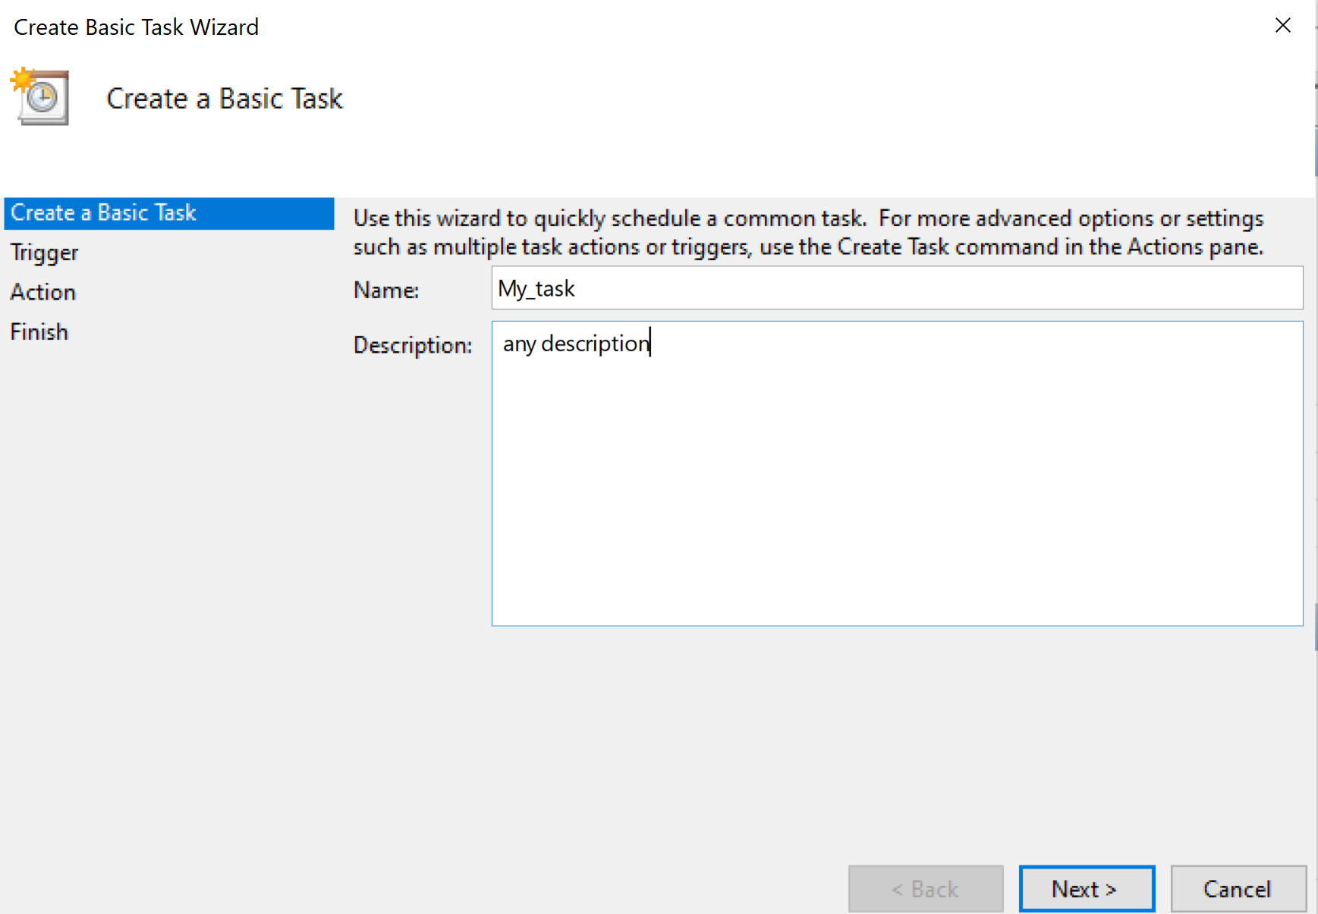
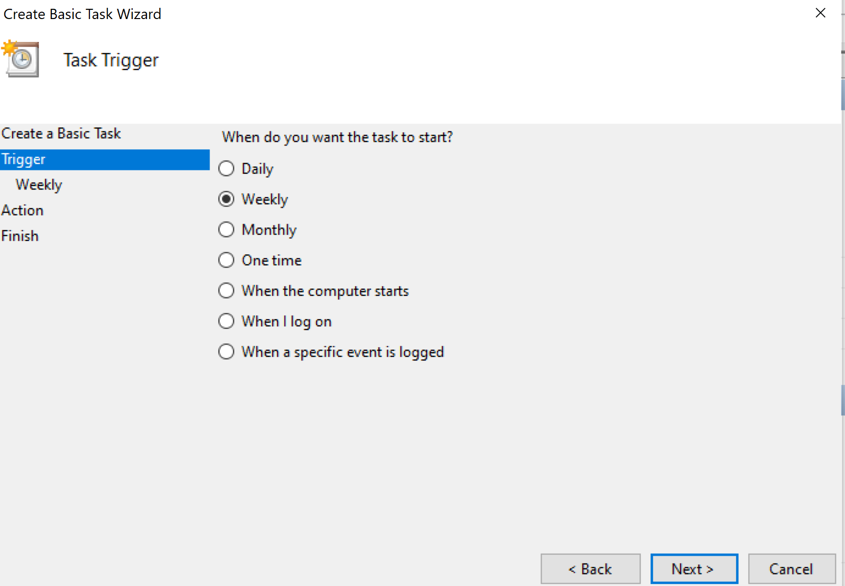

Slide 15
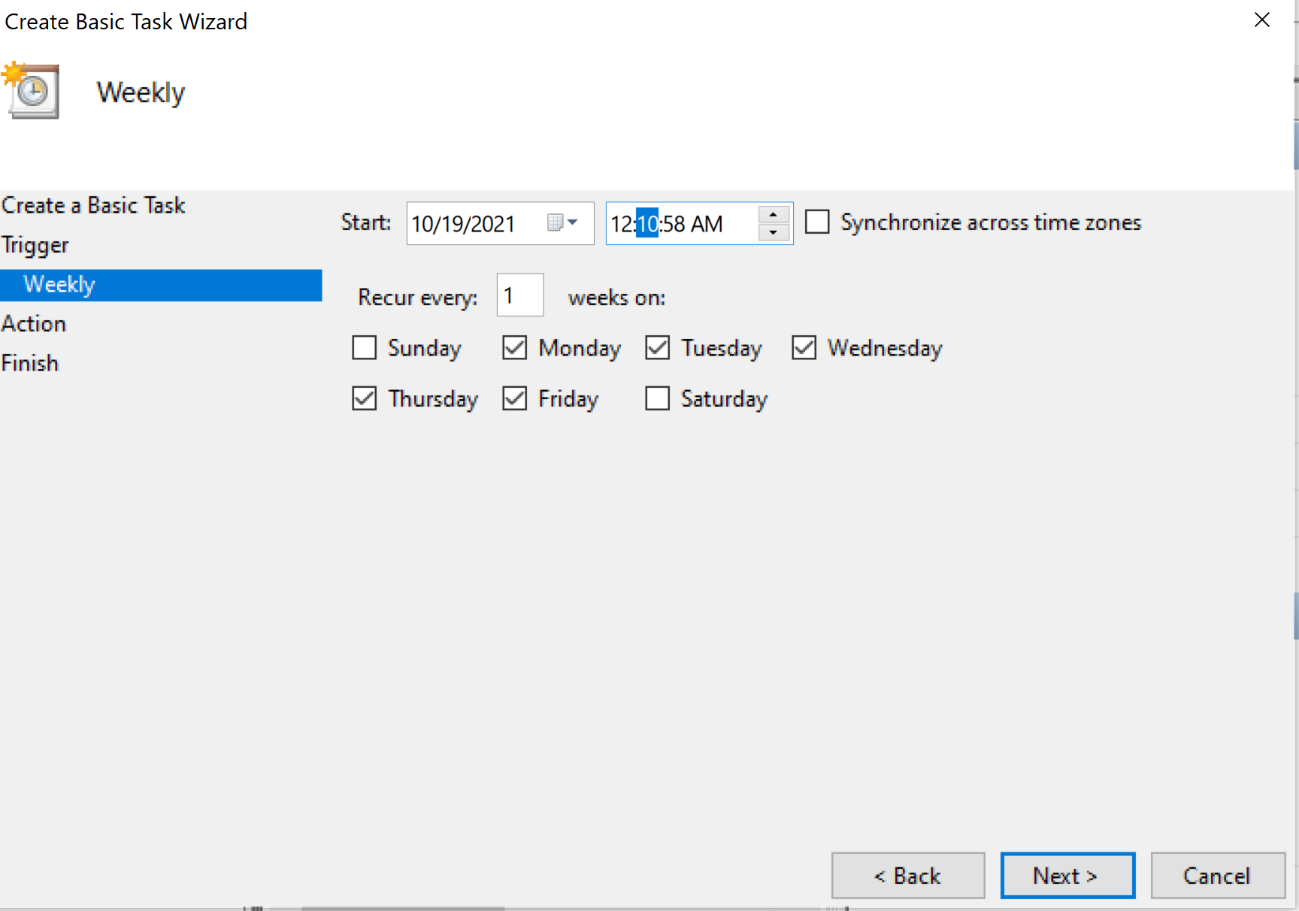
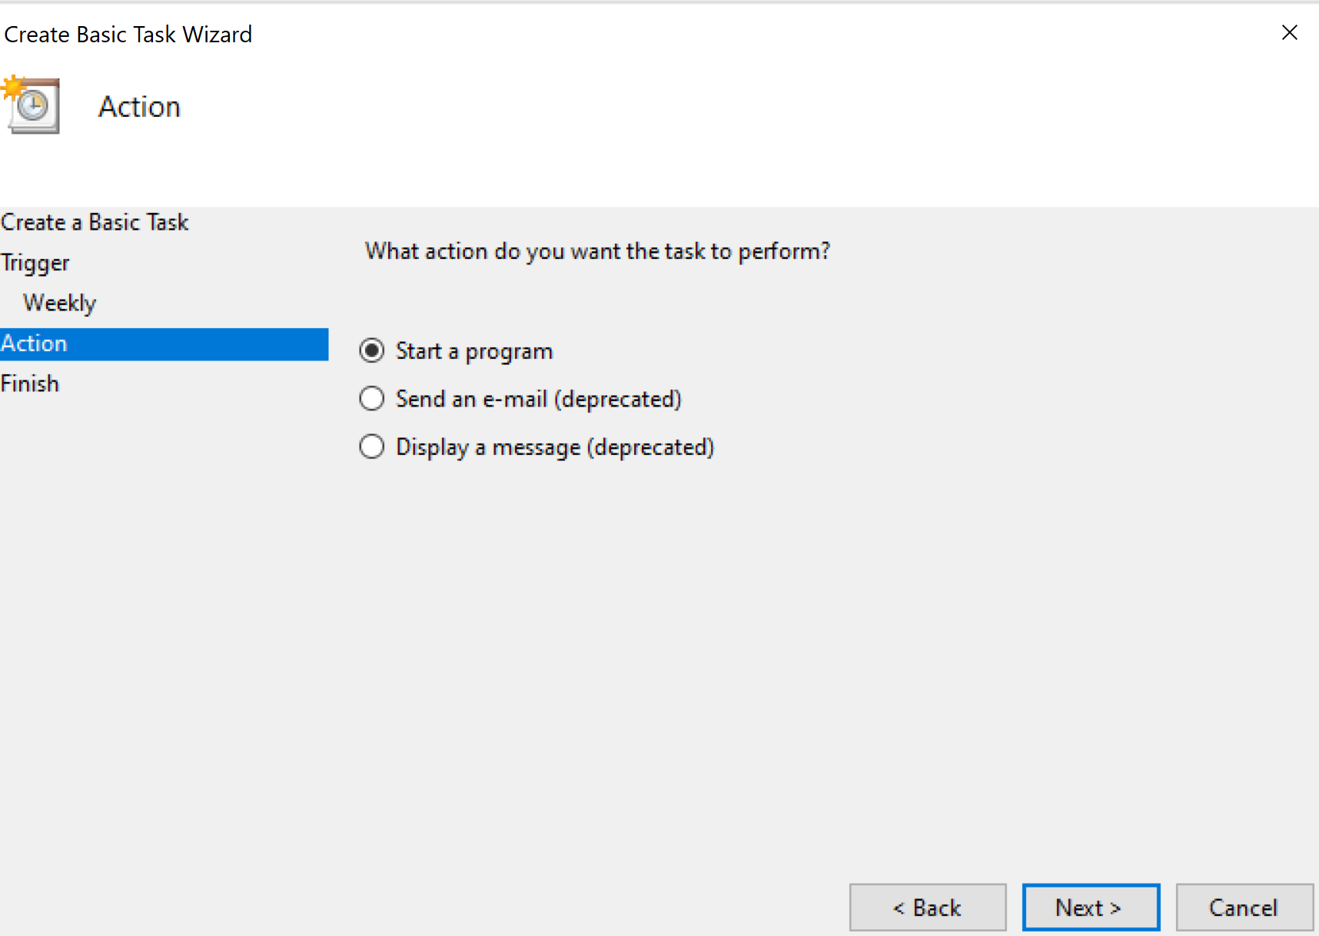

Slide 16
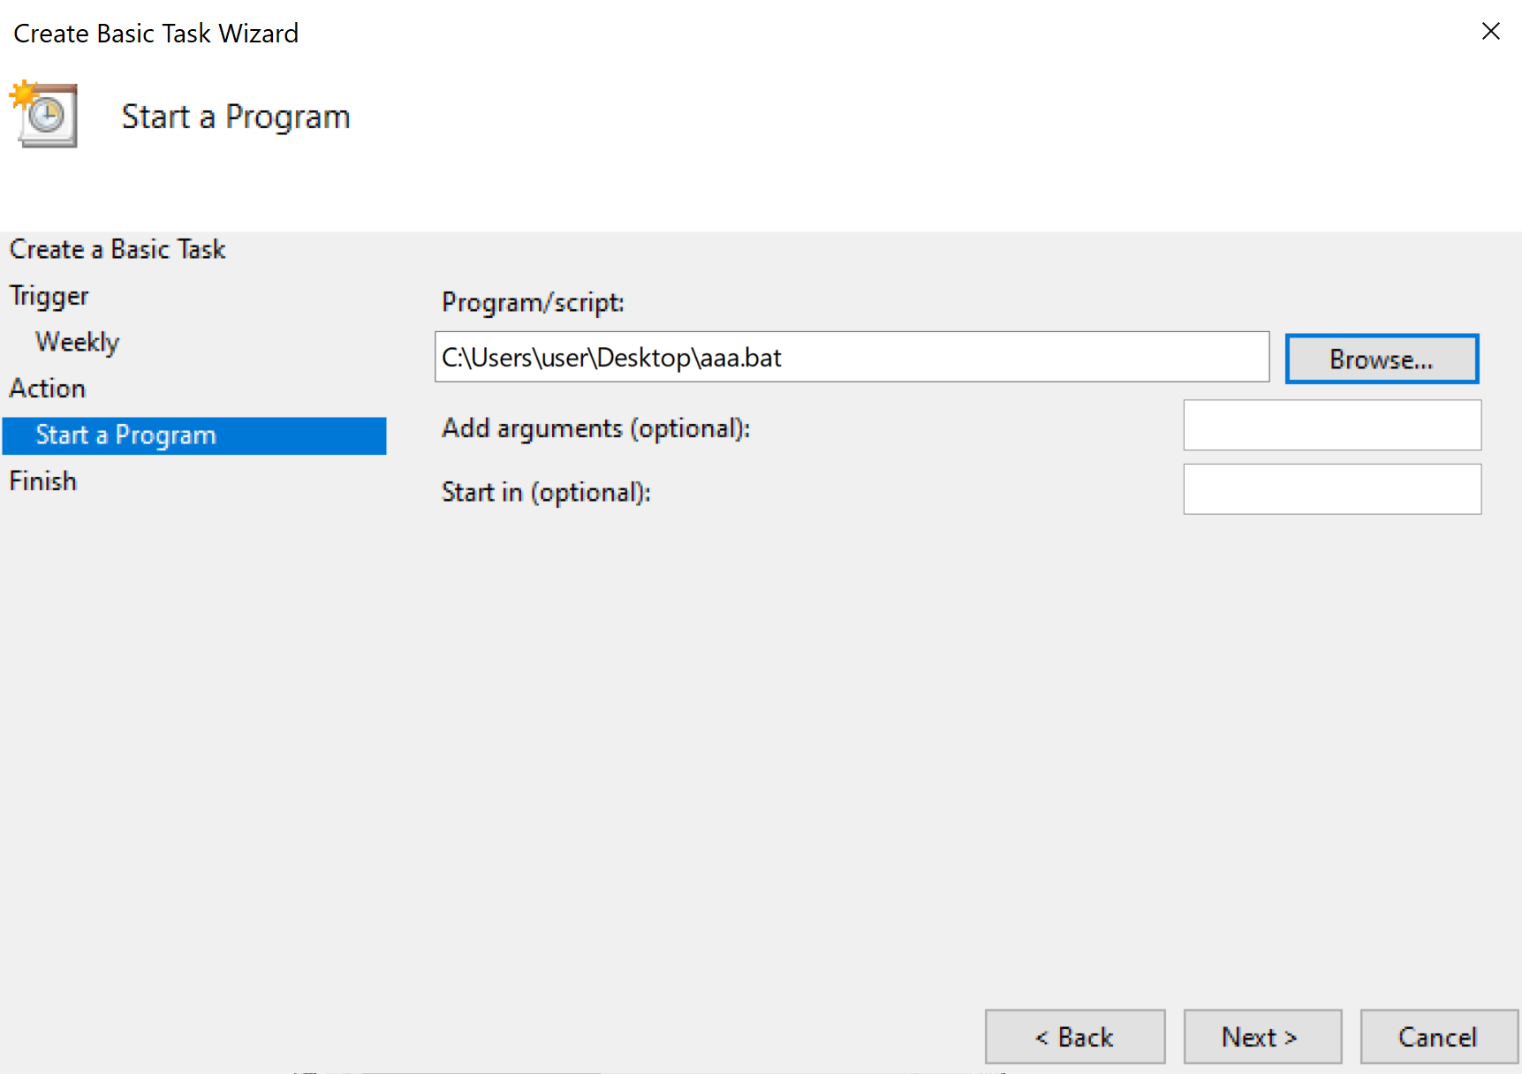
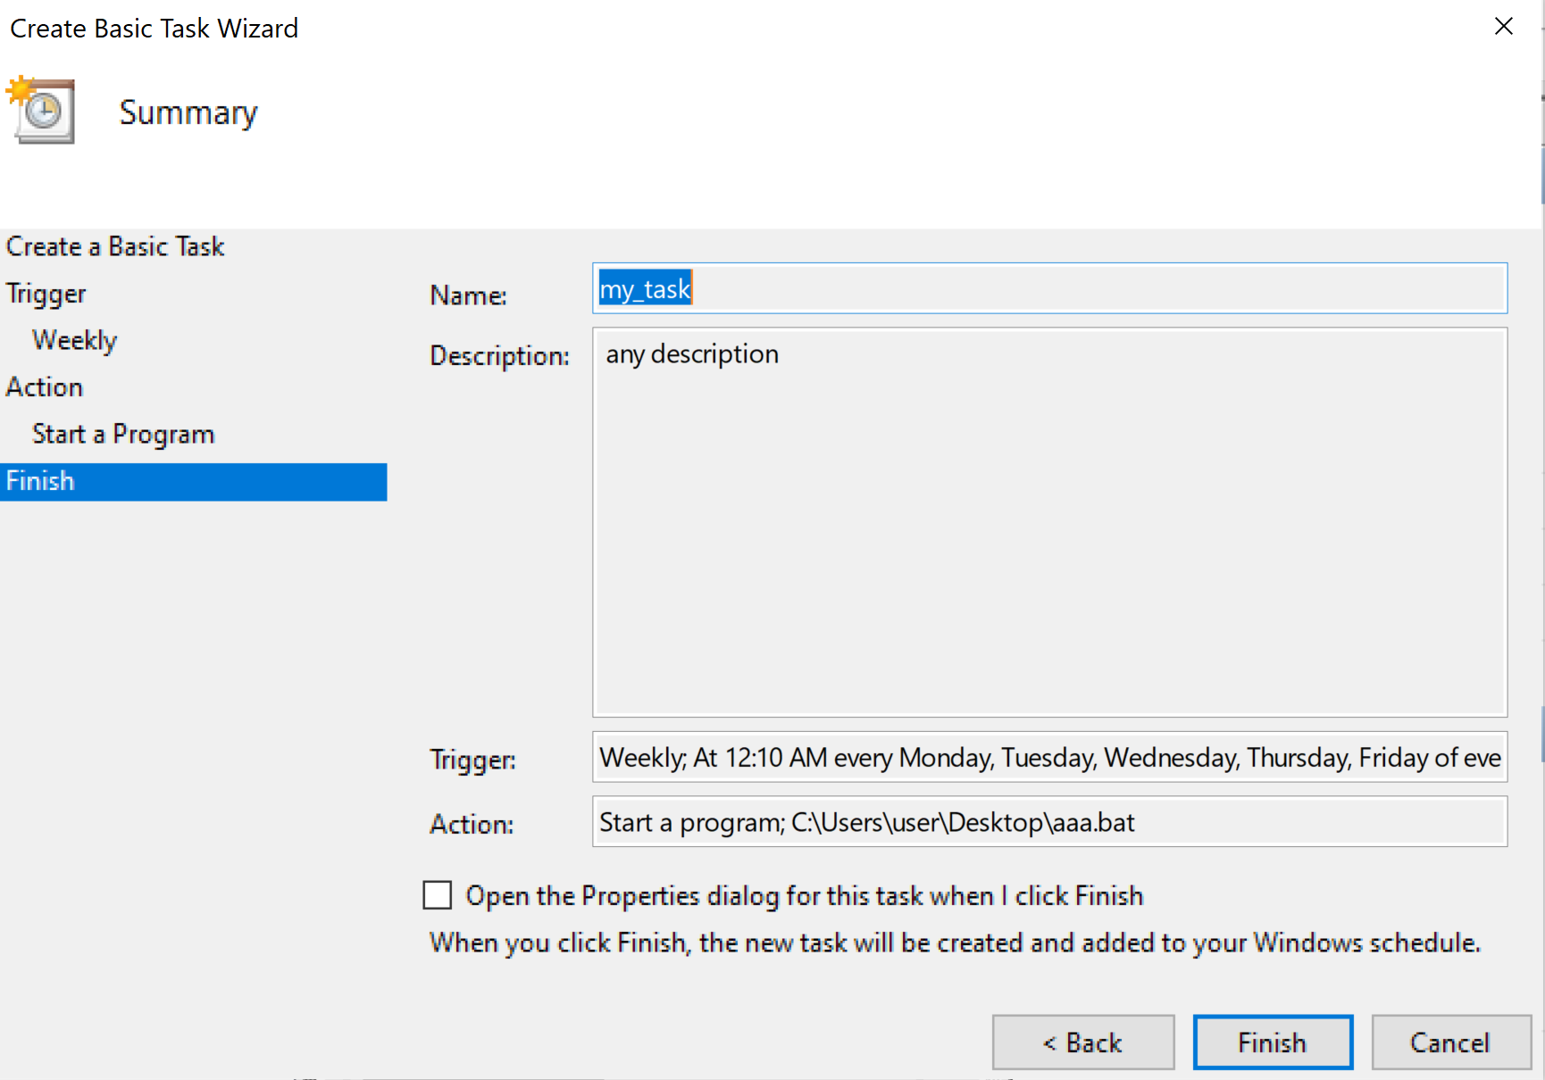

Slide 17
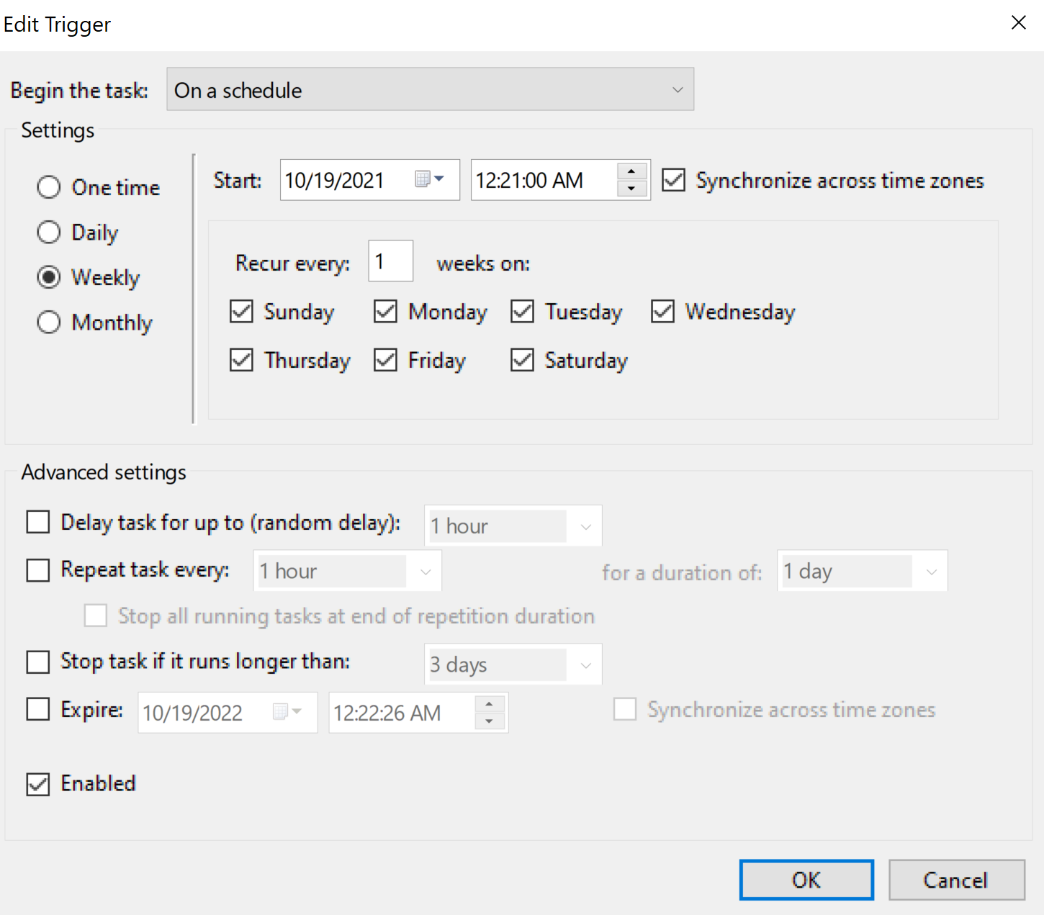
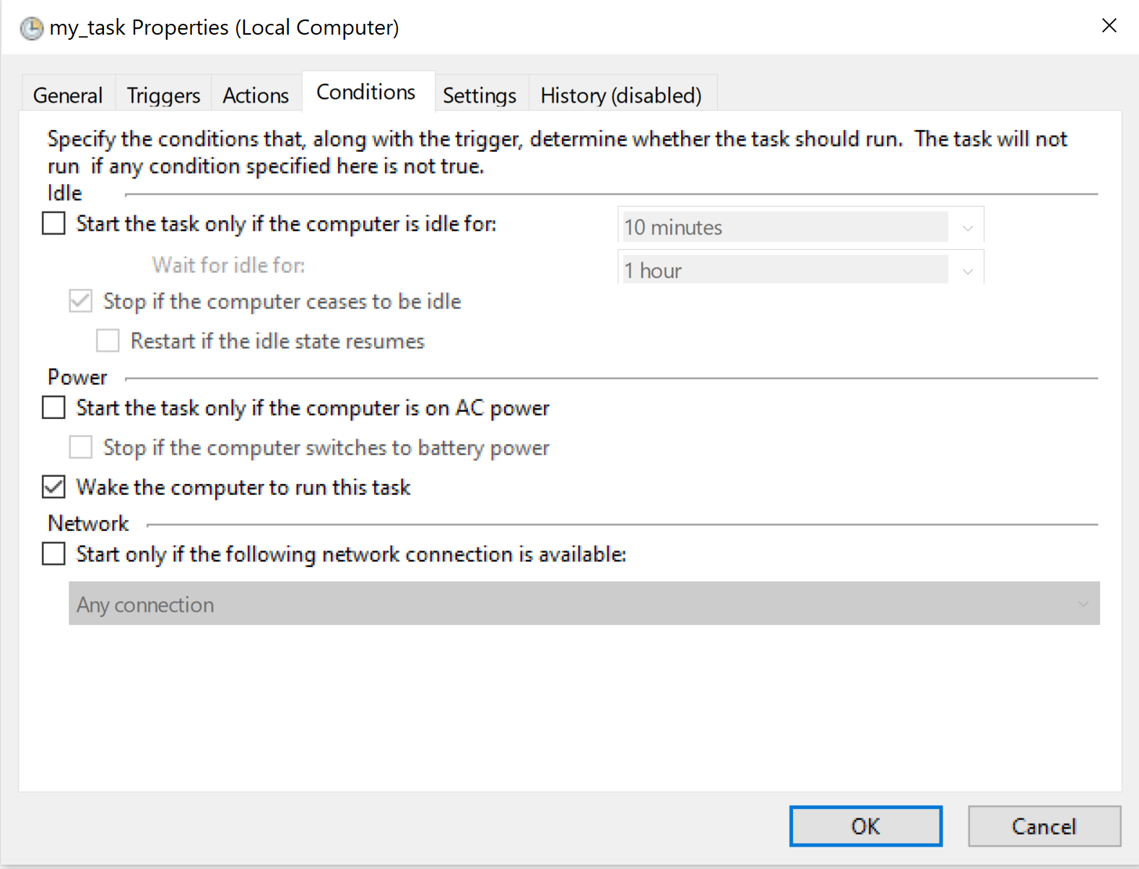

Slide 18
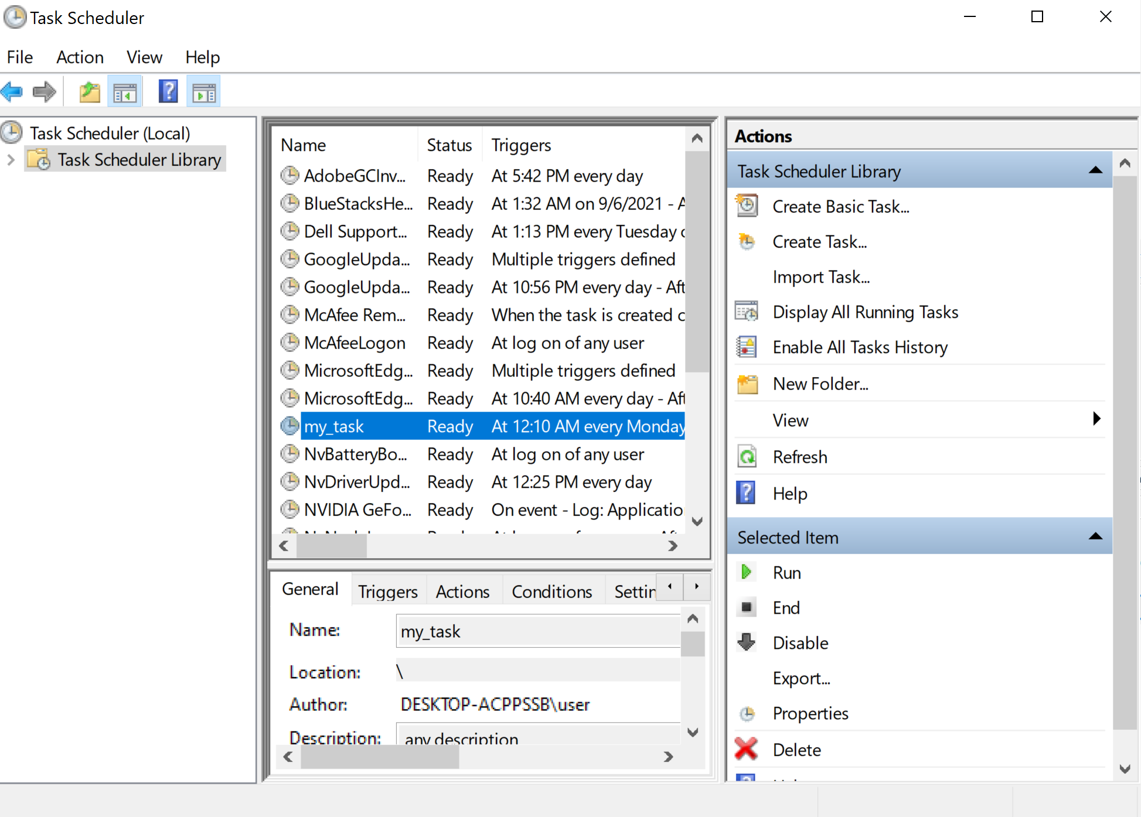

Slide 19
Helpful links
https://packaging.python.org/guides/installing-using-pip-and-virtual-environments/
https://www.askpython.com/python/environment-variables-in-python#:~:text=Environment%20Variables%20in%20Python%20%E2%80%93%20Read%2C%20Print%2C%20Set,the%20operating%20system%20and%20the%20current%20user-specific%20configurations.
https://appdividend.com/2019/11/28/how-to-set-environment-variables-in-python-example/#:~:text=Why%20use%20Environment%20Variables%20in%20Python%20Environment%20variables,want%20these%20credentials%20stored%20in%20your%20code%20repository
https://datatofish.com/batch-python-script/

Slide 20
Contact Us
+374 41 404 201

